Slide 1
Making OpenSAMM More Effective in a DevOps World
John B. Dickson, CISSP
@johnbdickson

Slide 2
Agenda
Background
SAMM Overview
Benchmarking Initiative Update
Reality of Devops & Agile
Strategies to Make OpenSAMM More Effective
Questions

Slide 3
John’s Background
AppSec Guy
Helps CSO’s and CISO’s with
Application Security Programs
ISSA Distinguished Fellow
Security Author and Speaker
OpenSAMM Benchmarking Initiative
Notes:
5,835 mi between San Antonio & Rome 9390.522

Slide 4
My Background
Dan Cornell, founder and CTO of Denim Group
Software developer by background (Java, .NET, etc)
OWASP San Antonio
OWASP OpenSAMM Benchmark

Slide 5
Denim Group Background
Secure software services and products company
Builds secure software
Helps organizations assess and mitigate risk of in-house developed and third party software
Provides classroom training and e-Learning so clients can build software securely
Software-centric view of application security
Application security experts are practicing developers
Development pedigree translates to rapport with development managers
Business impact: shorter time-to-fix application vulnerabilities
Culture of application security innovation and contribution
Develops open source tools to help clients mature their software security programs
Remediation Resource Center, ThreadFix
OWASP national leaders & regular speakers at RSA, SANS, OWASP, ISSA, CSI
World class alliance partners accelerate innovation to solve client problems

Slide 6
Value and Risk Are Not Equally Distributed
Some Applications Matter More Than Others
Value and character of data being managed
Value of the transactions being processed
Cost of downtime and breaches
Therefore All Applications Should Not Be Treated the Same
Allocate different levels of resources to assurance
Select different assurance activities
Also must often address compliance and regulatory requirements

Slide 7
Software assurance Frameworks and opensamm

Slide 8
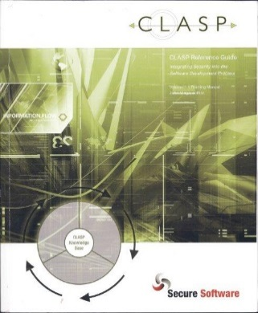
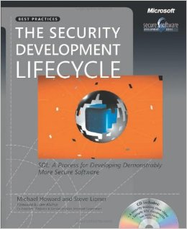
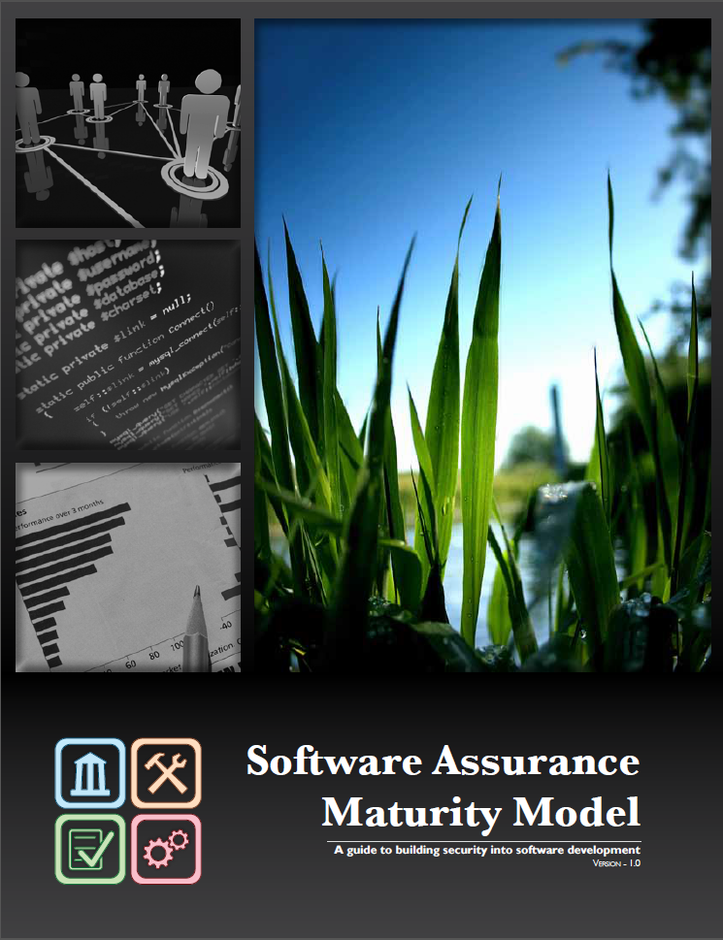
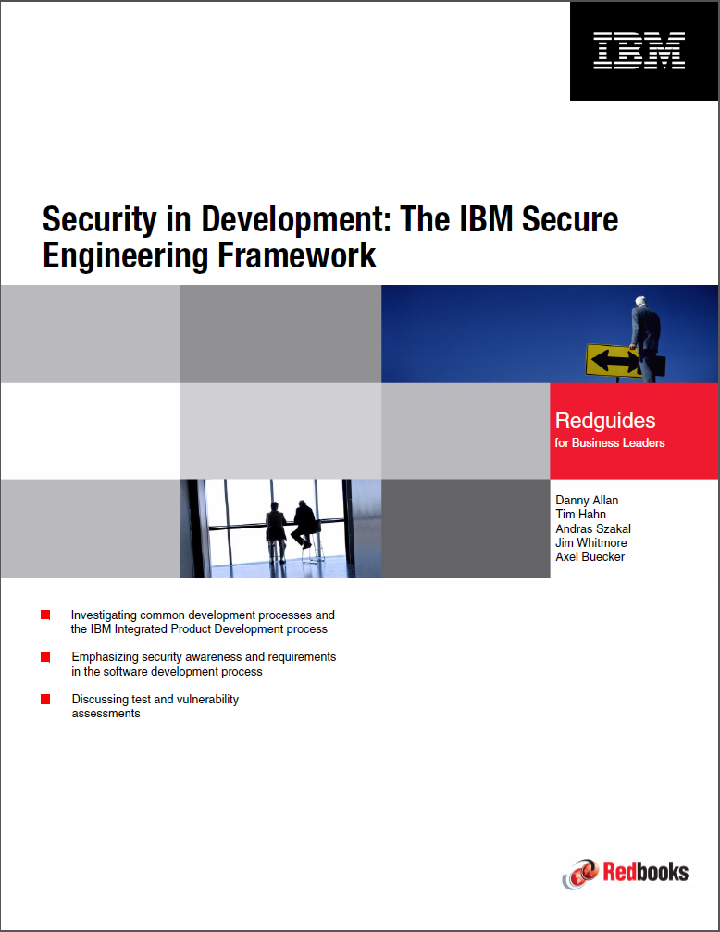
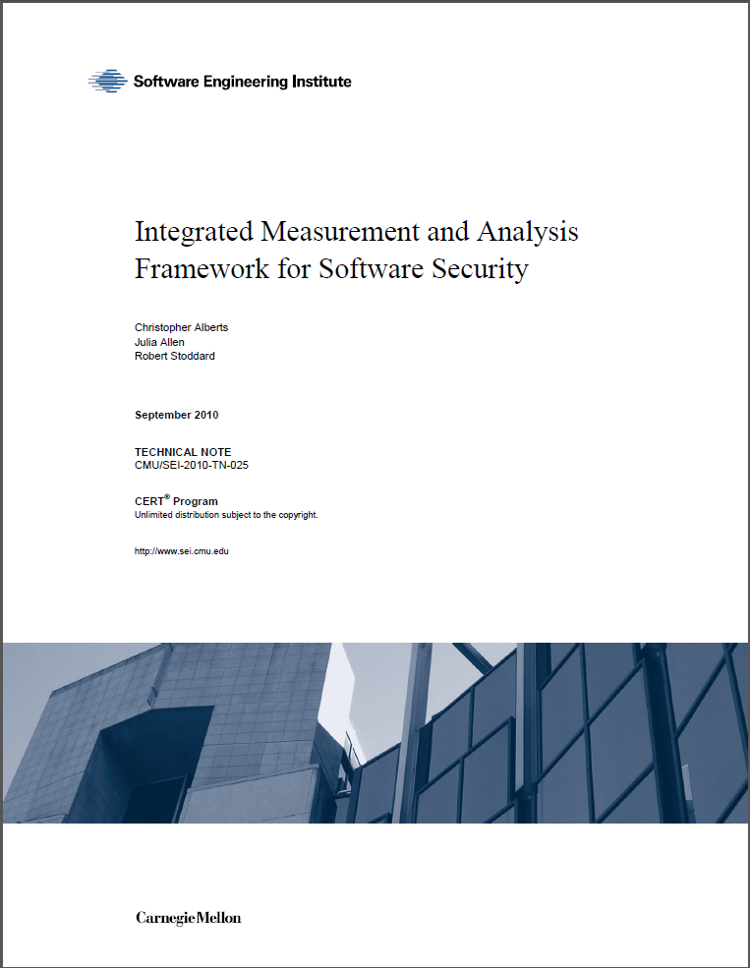
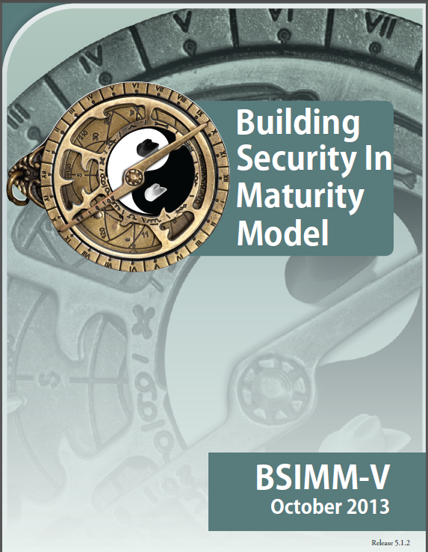
Software Assurance Frameworks*
2005
2006
2008**
2010
2010
2013
*Examples Only; not intended to be a comprehensive list **OpenSAMM update scheduled for CY2015

Slide 9
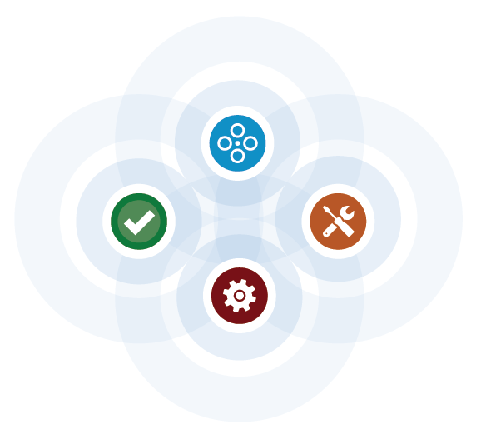
OpenSAMM Design Intent
The Software Assurance Maturity Model (SAMM) is an open framework to help organizations formulate and implement a strategy for software security that is tailored to the specific risks facing the organization. The resources provided by SAMM will aid in:
Evaluating an organization’s existing software security practices
Building a balanced software security assurance program in well-defined iterations
Demonstrating concrete improvements to a security assurance program
Defining and measuring security-related activities throughout an organization
Source: Software Assurance Maturity Model

Slide 10
OpenSAMM Business Functions
Start with the core activities tied to any organization performing software development
Named generically, but should resonate with any developer or manager
Source: Software Assurance Maturity Model

Slide 11
OpenSAMM Security Practices
From each of the Business Functions, three Security Practices are defined
Security Practices cover all areas relevant to software security assurance
Source: Software Assurance Maturity Model

Slide 12
OpenSAMM in Practice
 | Example OpenSAMM Scorecard
 |  |  |  |  | Level 1
 |  |  |  | Maturity Level | Activity
Business Functions | # | Security Practices/Phase |  |  | A | B
Governance | 1 | Strategy & Metrics |  | 0.5 | 0 | 1
 | 2 | Policy & Compliance |  | 0.5 | 0 | 1
 | 3 | Education & Guidance |  | 0 | 0 | 0
Construction | 4 | Threat Assessment |  | 0 | 0 | 0
 | 5 | Security Requirements |  | 0.5 | 0 | 1
 | 6 | Secure Architecture |  | 0 | 0 | 0
Verification | 7 | Design Review |  | 0.5 | 0 | 1
 | 8 | Code Review |  | 0 | 0 | 0
 | 9 | Security Testing |  | 0 | 0 | 0
Deployment | 10 | Vulnerability Management |  | 1 | 1 | 1
 | 11 | Environment Hardening |  | 1 | 1 | 1
 | 12 | Operational Enablement |  | 0 | 0 | 0
 |  | SAMM Valid Maturity Levels
 |  | 0 | Implicit starting point representing the activities in the Practice being unfulfilled
 |  | 1 | Initial understanding and ad hoc provision of Security Practice
 |  | 2 | Increase efficiency and/or effectiveness of the Security Practice
 |  | 3 | Comprehensive mastery of the Security Practice at scale
 |  |  |  | Legend
 |  |  |  |  | Objective Activity was met.
 |  |  |  |  | Objective Activity was not met.
Notes:
Background
SAMM’s can be effective for organizations to use to understand maturity of security practices in their development teams
Focus has been on organizations, but increasingly a focus on team-based maturity given the wildly different types of:
Software languages
Frameworks
Development practices (SDLC’s)
Testing tools
Let alone geography
What does 2.26 tell you (nada

Slide 13
Opensamm benchmarking update

Slide 14
OpenSAMM Benchmarking Initiative
Important because business leaders crave data
They want to know how they are doing relative to others
Don’t want to ”overspend” either!
Focus of effort was for team-based data, which helps with:
Future improvement of team
Team vs. team competition around security flaws
Notes:
Overview of OpenSAMM project
Newest version
Benchmarking initiative
These efforts are focused on updating the OpenSAMM model and providing comparative data that allows clients to understand their software security maturity compared to industry peers. The session will also provide a brief overview of where OpenSAMM can provide tremendous value in any application security program, when and where they should be used, and how security organizations should capitalize on their results.

Slide 15
Data Model – High Level (continued)
Granularity
Organization versus Team
Organization / Team Metadata
Employee/Developer/DevSec count (ranges) (team and org)
Sector (org)
Region (org)
Differing depths of data supported
Crowd sourced versus centrally sourced
Inclusive, not exclusive
Quality of data
Give you what you need to make your own decisions

Slide 16
What Limits SAMM in the Real World?
Ambitious development timelines (the option to say “no thanks!”)
Limited resources
Crazy deadlines
Politics
Other competing priorities
Notes:
Particularly in Larger organizations….
Story of 22/500 Developments

Slide 17
What is Changing Our World?
The Need for Speed!
Agile &
DevOps
Notes:
Particularly in Larger organizations….
Story of 22/500 Developments
Filer t

Slide 18
Why is this Happening?
Time-to-Market advantages
Demand of higher quality software products
Cost concerns
Key thought: Like cloud, DevOps will come from business units responding to competitive pressures, not IT or outside pressure
Notes:
Particularly in Larger organizations….
Story of 22/500 Developments
Filer t

Slide 19
How did we Get to DevOps?
Waterfall Agile DevOps Secure DevOps
Business
Development
Operations
Security
Notes:
Particularly in Larger organizations….
Story of 22/500 Developments
Filer t

Slide 20
More Reason not to do SAMM’s if you Haven’t Already!
Lots of time and energy (opportunity cost)
No one is itching to get a big fat “zero” on their report
It’s an expensive way of confirming what you suspected already
Namely, that they have far fewer security practices implemented in their SDLC and have to invest even more time and resource
Notes:
Particularly in Larger organizations….
Story of 22/500 Developments
What limits OpenSAMM’s effectiveness?
Some organizations may
Be moving too fast
View OpenSAMM of dubious value
May already be moving a 1m MPH and openly question relevance
Developers can still say “no!”

Slide 21
So What do you Do?!?

Slide 22
Key Concepts
Show value early in the process
Make data capture as painless as possible
Crowdsource with what numbers you have…
Iterate….
Show small wins and expand
Pivot, if need be
Notes:
What adaptations are needed to provide a range of options to orgs looking to capture maturity levels in security of s/w in an agile way?

Slide 23
How do you Adapt SAMM?
How can you benchmark against peers and other teams?
How can you show value to dev team and biz units early in the process?
How do you make SAMM less disruptive?
How do you communicate SAMM success?
Notes:
What adaptations are needed to provide a range of options to orgs looking to capture maturity levels in security of s/w in an agile way?

Slide 24
Strategy 1– Conduct Data-Driven Benchmarking
Leverage what external benchmarking information you can
Pilot by picking one internal development team and baseline their maturity
Preferably one team that you suspect will have positive results
Gather information from other development teams
Start with low hanging fruit (teams likely to respond)
Notes:
- Data collection is a pain, but without it, you are ill-equipped to have fact-based discussions with your development and IT Leadership. Find the way to get the most amount of data the quickesst

Slide 25
Conduct Data-Driven Benchmarking
Conducting data collection is a necessary evil.
(Emphasis on the “necessary” part)
Notes:
- Data collection is a pain, but without it, you are ill-equipped to have fact-based discussions with your development and IT Leadership. Find the way to get the most amount of data the quickesst

Slide 26
Strategy 2 – Streamline Collection Process
Invoke higher authority
Leverage existing app inventory
Use sampling
Lightweight versions
Self-assessments
In-person as a last resort
Notes:
Minimize impact on development teams
However, companies need a range of flexible options
Weight accordingly
Why do they need these options?
To allow them to adapt the underlying concepts of the OpenSAMM
While minimizing the impact on software development production

Slide 27
Streamline Collection Process - Key Concepts
Minimize impact
Use incentives
Notes:
Minimize impact on development teams
However, companies need a range of flexible options
Weight accordingly
Why do they need these options?
To allow them to adapt the underlying concepts of the OpenSAMM
While minimizing the impact on software development production

Slide 28
Strategy 3 – Consider Multi-tier Collection Process
Focus on coverage at the expense of exhaustiveness
Breadth vs. depth
Consider a preliminary light-weight survey to identify the the development teams with the most risk
Based upon initial results, conduct in-person interviews to identify quantify risk and get more detail
Ignore the rest of the teams
Notes:
Remember 80/20 rule – adapt collection process if need be
Focus limited resources after your initial collection process to ID most risk
Consider face-to-face interviews for the most risky

Slide 29
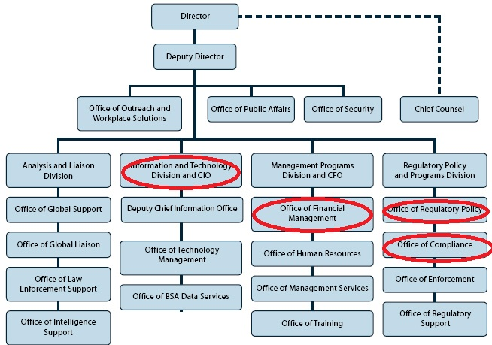
Breadth over Depth
Notes:
due care - the care that a reasonable man would exercise under the circumstances; the standard for determining legal duty

Slide 30
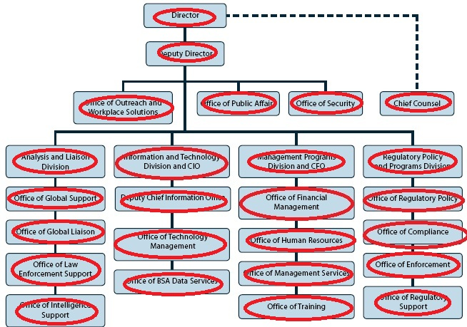
Breadth over Depth
Notes:
due care - the care that a reasonable man would exercise under the circumstances; the standard for determining legal duty

Slide 31
Multi-tier Collection Process (Cont)
Focus on technology stack with less automated scanning coverage
The Java & .NET web teams just might be OK!
After you feel you have ”near-100% coverage” conduct a risk ranking
Remember 80/20 rule – adapt collection process if need be and revisit teams
Notes:
Remember 80/20 rule – adapt collection process if need be
Focus limited resources after your initial collection process to ID most risk
Consider face-to-face interviews for the most risky

Slide 32
Strategy 4 – Explicitly Communicate Value to Leadership & Dev Managers
More critical aspect given compressed timelines
Develop a communication plan as key aspect of assessment process
Come up with an agreed upon communications tempo
Communicate to executives to demonstrate value to the business

Slide 33
Communicate Value to Leadership & Dev Managers
Communicate laterally to development teams to show progress
Developers do not like to be at the bottom of the leader board

Slide 34
Conclusion
Using benchmarking data when/where you can
Show value early and often
Focus on breadth and not depth in collection
Overcommunicate…

Slide 35
Questions / Contact Information
John B. Dickson, CISSP
Principal
john@denimgroup.com
Twitter @johnbdickson
001.210.572.4400
www.denimgroup.com
www.threadfix.it

