Slide 1
Attack Tree Vignettes for CaaS
Tony UcedaVelez

Slide 2
Attack Tree Vignettes for CaaS
Attacking Containers as a service via risk centric threat models

Slide 3
Process for Attack Simulation & Threat Analysis
1. Define Objectives
Identify Business Objectives
Identify Security & Compliance Requirements
Business Impact Analysis
2. Define Technical Scope
Capture the boundaries of the technical environment
Capture Infrastructure | Application | Software Dependencies
3. Application Decomposition
Identify Use Cases | Define App Entry Points & Trust levels
Identify Actors | Assets| Services | Roles| Data Sources
Data Flow Diagramming (DFDs) | Trust Boundaries
Secondary Focus
4. Threat Analysis
Probabilistic Attack Scenarios Analysis
Regression Analysis on Security Events
Threat Intelligence Correlation & Analytics
5. Vulnerability & Weakness Analysis
Queries of Existing Vulnerability Reports & Issues Tracking
Threat to Existing Vulnerability Mapping Using Threat Trees
Design Flaw Analysis Using Use & Abuse Cases
Scorings (CVSS/ CWSS) | Enumerations (CWE/CVE)
6. Attack Modeling
Attack Surface Analysis
Attack Tree Development | Attack Library Mgt
Attack to Vulnerability & Exploit Analysis using Attack Trees
Primary Focus
7. Risk & Impact Analysis
Qualify & quantify business impact
Countermeasure Identification & Residual Risk Analysis
ID risk mitigation strategies

Slide 4
Outline
Why this talk matters (Significance)
Threat Motives & Attack Vignette (Harms)
Attack Tree Vignette
Countermeasures (Solvency)

Slide 5
Speaker
Author of ‘Risk Centric Threat Modeling’, Wiley 2015
CEO, Founder of VerSprite, (www.versprite.com)
20 year background in dev, sys admin, network eng, architecture, security
OWASP ATL Chapter Leader
@t0nyuv
tonyuv@versprite.com

Slide 6
Significance
Proliferation of Containerization

Slide 7
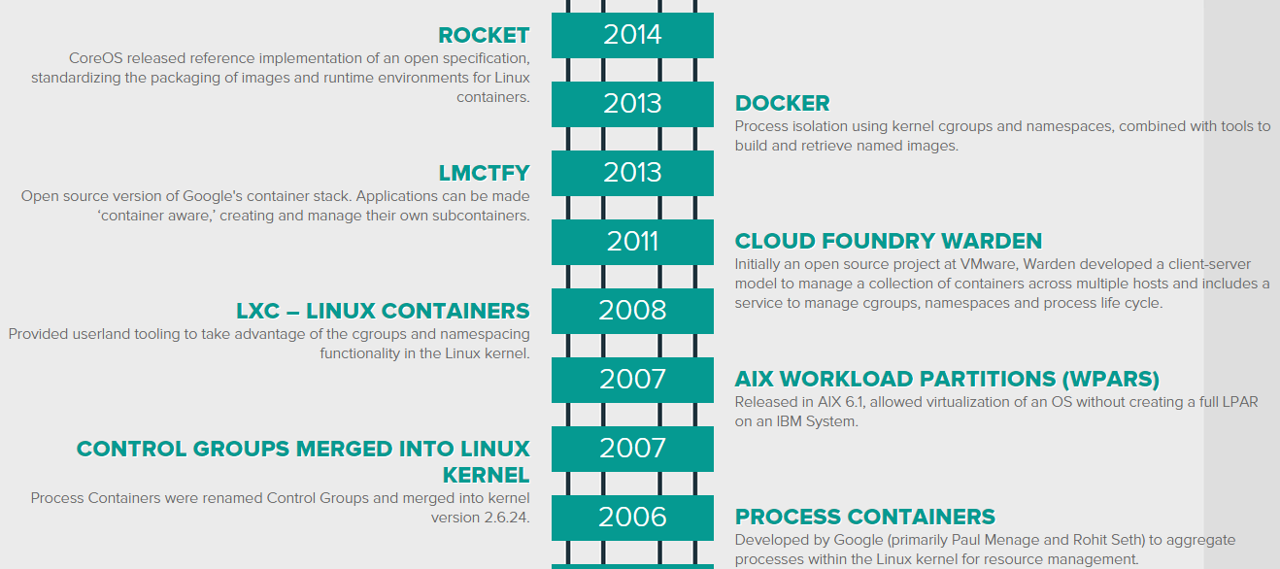
Container Proliferation
Containers are not new. Rapid adoption is.
Google, Amazon lead the way. 2B Containers launched weekly at Google.
Technology change ushers in changes to attack patterns
Notes:
Google starts nearly 2Billion containers every week.
Explain technology use in context of attacking
Stage II of PASTA
Both process and technology are important for hacking/ social engineering

Slide 8
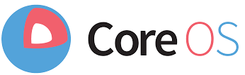
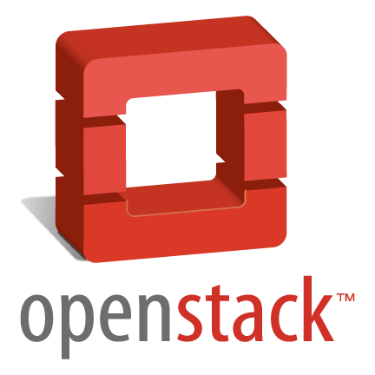
Growing Adoption, Shifting Attack Surface
Docker, Rocket containers
Kubernetes, mesosphere container orchestration
Securing the Stack via Containerization
PASTA, Stage II – Technology Discovery & Enumeration
Chef, Puppet bake security configuration into templates
Jenkins – tests code & builds Docker images
Notes:
- Google starts nearly 2Billion containers every week.

Slide 9
Container Commands that Run Your Services & Apps
Source: Anthony Bettini

Slide 10
Evolving Attacks, Weaknesses
Shifting Targets
Abuse Cases against Weak Containers
DevOps Team Members
NetSec Groups
Open Source Marketplaces/
Repos
Container breakout via kernel exploit
Mis-configuration opportunities
Privilege escalation via root
Illicit network ACL requests
Speed of Deployments
Dependency check freedom
Notes:
Speed of Deployments: By containerizing individual application services, devops groups can built at their own pace, lifecycle, and resource level. This theoretically is done to limit dependencies on other application deployments. Ease of rollback provides for some mitigation but timing a rollback with abuse cases in rollback code (e.g. – Osint operatives or rogue, non-destructive, non-monitored actions to outside entities
DevOps/ NetSec groups do not configure proper ACLs for kernel FW Iptables Docker Hosts is an example of security network configuration; Discovery of Docker APIs
Mis-Configuration: Recently, poor key management

Slide 11
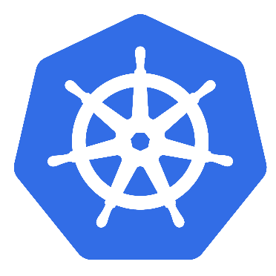
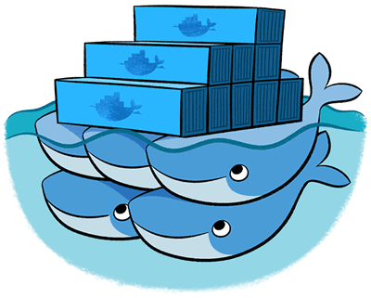
Proliferation’s Significance to Threat Agent(s)
Shift to DevOps refocuses OSint
Scope of Attack (Hosting model)
Technology footprint
Workflows
Architecture
End of Generic Attack Patterns
Targeted Attacks on Process & Tech
Orchestration selection may alter attack patterns
Notes:
Shift to DevOps refocuses OSint – multi-vector recon channels need to be more sophisticated in order to collaborate intel against targets
Hosting Models:
SaaS, PaaS, CaaS, IaaS models
Layers of specialty, layers of ignorance
Technology footprint
How do you know something is containerized? Do you care as an attacker? Depends on attack level
Need to enum technology from Dev (frameworks, languages, etc.) to Ops level (orchestration, instrumentation)
Workflows
Attackers will harvest intel on workflows due to ‘openness in sharing’ lessons learned (i.e. – blog posts, tweets, etc.)
Instrumentation & Orchestration – rogue process and technology injection
Service development and management
Architecture
Private – Public Consolidation
End of monolithic apps to rise of monolithic architecture

Slide 12
Factors Supporting Cloud Threat Models
Cloud management fails (process flaw)
Mis-configuration (process/ tech flaw)
Cloud insider (threat agent)
Tenant hopping (attack pattern)
Broken trust models (weakness)
Notes:
Cloud management fails mail easily relate to:

Slide 13
Threat Motives & Attack Vignettes
Foreshadowing Abuse Cases in DevOps

Slide 14
Container Use to Abuse Case Mapping
Containers Use Cases
Container Abuse Cases
Decoupling
Process Isolation
Resource Dependency
Web-enabled APIs
Container marketplaces
Opportunities for implicit trust abuse
More actors w/ poorly assigned privs
Host resource (kernel) hacking
Larger attack surface
Tainted containers
Notes:
More actors w/ poorly assigned privs = daemon privilege misconfiguration (used of –privileged); users assigned to run docker daemon
Host resource (kernel) hacking can be achieved by poorly defined, explicit configurations in Cgroups
Ex: CPU usage: docker run -it --rm --cpuset=0,1 -c 2 ...
Also: the intrinsic security of the kernel and its support for namespaces and cgroups;
Web-Enabled APIs : trust boundary from hell needed. Trusted calls, parameter inspection, validation on outbound and inbound.
Tainted Containers: loopholes in the container configuration profile, either by default, or when customized by users.

Slide 15
Dissecting Container Components [Targets]
Docker run → Namespace
Achieve network isolation
CGroups → availability control of kernel resources
Docker Daemon
runs as root
/host = / on host system
Vulnerable to other inputs (load & pull)
Shared services (?)
REST API
Can be exposed
Arbitrary commands via fuzzing
Dockerfile (affects builds)
Can be tainted
Infiltrate DockerHub or Registry
Multiple options given numerous functions within a tainted image
Docker Client
Docker Registry
Docker API
Docker Namespace
Docker Daemon
Notes:
Docker Daemon > Shared Services – this means that if Docker is run on a server with other services or apps, arbitrary references to those libraries, binaries, etc. could be used and manipulated.
Which is most attractive to you????

Slide 16
DevOps Attack Pattern - “Dishing”
Serving deliberately tainted images to a marketplace
Goal is mass deployment and consumption of images with vulnerabilities or backdoors
Convenience of pre-built images is too tempting
Relying on speed of DevOps workflows and increase business/ IT pressures
Like most (in)security initiatives, weak or immatures processes around open source security testing

Slide 17
Historical Container Weaknesses
Absence of user spaces
History: LXC adopted as model container
Docker: Early versions susceptible to tenant breakout
Adding users to Docker groups (inherits root privs)
chmod +s <target volume>
Other misconfiguration gafs
Knowing what actor can run Docker in your containers
Higher privs, more container breakout issues (ex: /var/run/docker.sock)
Review your Dockerfile
Notes:
Linux containers (LXC) were easy to use, understand and were built for efficiency, not multi-tenancy
Early adoption of technology and rate of IT supporting business is conducive to configuration gafs

Slide 18
Ripe for “Dishing”

Slide 19
Poison Open Source Libs
Speed of deployment, ease of use shortcuts security validation of rogue container files

Slide 20
Precedence of Attack Patterns
Vulnerable Images across Marketplace
Multiple attack vectors available via tainted image
Kernel based exploits
Docker Container Breakout Proof of Concept Exploit
Legacy LXC code found to be vulnerable
Exploit was around running untrusted apps w/ root priv
MITM for DockerHub Access
HTTP access by default for DockerHub Access
Notes:
RE: Kernel exploits: Docker Enginer 0.12 – 1.0 drops all kernel capabilities by default

Slide 21
Containerized Attack Surface
Submitting
Tainted images
Exploiting insecure /etcd dir
Injecting
arbitrary
commands
Social eng of DevOps
Exploit memory mis-allocations,
Catching unhandled exceptions,
Other bugs
Tainted cmds for container build
Notes:
CoreOS - etcd supports SSL/TLS as well as authentication through client certificates,
Kubernetes - The API server is the only component that speaks directly to etcd. When starting the API server, you can pass a --etcd-config=/path/to/client/config parameter instead of just pointing to an unsecured etcd server with --etcd-server
Zookeeper Example: java.lang.OutOfMemoryError: Java heap space in Zookeeper

Slide 22
Personal Services Attack Vignette
Uber Case Study in CaaS & Exercising Possible Attack Patterns

Slide 23
Adoption, Advertising, & Attack Vectors
…
“Docker provides consistency for both build and run time environments. It has helped Uber reduce their footprint of Debian packages as well. Makes it easy to updates certain images without having to reboot then entire fleet. They are now onboarding all of there new services into Docker, and will be onboarding all of their existing applications into Docker clusters. Docker containers also reduce time from weeks and months to minutes or hours, providing an isolation of resources so that applications no longer interference with one another.”
…

Slide 24
[Attacking] Uber’s Business Objectives
PASTA S1:A1 Biz Objectives of Target
PASTA S1:A2 Compliance Pain Points
Segment growth (e.g. – BlackCar service, Uber Pool, Trucking?)
Availability/ reliability of driver services
Credibility amongst riders and drivers
Cross-selling opportunities
PCI-DSS 3.1
Privacy laws (e.g. – State, Federal, EU, etc.)
Missing PASTA Activities (S1:A3 – Business Impact)
Notes:
Segment growth: gross rev from freight trucking exceeds $700 billion annually ; Cargomatic startup tackling this

Slide 25
Defining an Attack Surface for Containerized Targets
Uber Provided
OSInt Reveals
Uber Rides SDK
APIs
SOA backend services
Node.js (‘many services’)
Python/ Tornado
GoLang
Java
Backend Datastores
Riak & Postgres (Data stores)
Redis (caching layer)
Ringpop – ‘highly available consistent hash ring for app layer sharding of services’
BuiltWith Technology Profile
Nginx
Apache
AWS
Job Boards Intel
Python (Django?)
Hadoop
PostresSQL
pgBouncer
Node.js
Redis

Slide 26
App Decomposition (Blackbox)
Git
Notes:
Even from the outside, its easy to get a high level idea of work, data, call flow from DevOps groups supporting Uber
What is difficult is understanding the intra-container calls and the exact workflow around when containers are instantiated.
Also difficult is to know the exact manner in which container management is conducted.
Call/ Data flows would be opportunities for attack vectors.
Knowing actor privileges will vary based upon configuration or misconfiguration.
Risk centric approaches to reviewing use cases for abuse case preview

Slide 27
App Decomposition (Stage III – PASTA)
Blackbox
Whitebox
Exposed, discoverable containers
Social engineering
OSInt
Identify actors on Docker clients
Identify shared container nodes
Lynis can help audit (container image)
Nmap for exposed services/ ports
Notes:
Importance to understand application flows and container in order to formulate attack trees that are credidible
Use Cases beget Abuse Cases – get intel on use cases.
Blackbox approaches (when attacking as part of a simulation exercise or as real adversarial group)
Lynis log file can be audited if desired.

Slide 28
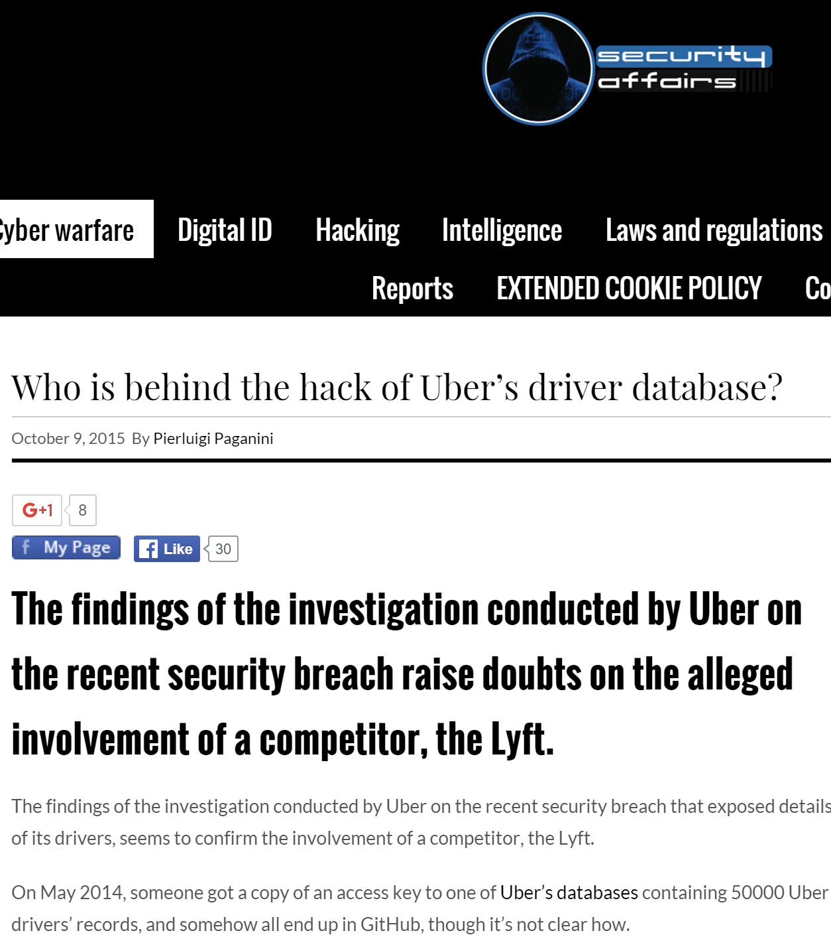
Threat Analysis for Personal Service Attacks (Stage IV)
IP Theft
Corporate Sabotage (ex: game nights, concerts, etc.
PII Compromise
Transaction fraud
Hacktivism
Notes:
Threat Motives help to frame threat assertions
Threat assertions should be supported by threat intel and threat data.
Threat assertions will identify possible threat agents and motives

Slide 29
Threat Assertions
Threat Claims
Threat Agents
(T1) want to steal drivers
(T1.1) Attacker need drivers contact information
(T2) I want to know driver contract terms with Uber (OSint)
(T3) I want (T1-T2) but want to frame target competitor
Competition (IT threat actors)
Bounty hunters
Foreign nation state actors

Slide 30
Sniffing Out Weaknesses…
Container Orchestration Weaknesses
Container Insecurity
Containers run as root
Low namespace adoption (Docker)
Use of public Docker registry/tainted containers via marketplace
Sharing containers w/ root
Insecure transport layers
Challenges w/ Client daemons (Docker
Misconfiguration
--net=host
Chroot for archive extraction
Priv escalation or RCE w/ elevated privs most attractive
Docker group runs w/ elevated privs
Exposed RESTful APIs susceptible to fuzzing
Notes:
--net=host basically uncontainerizes the container
Containers are running as elevated privileges by default (except Solaris containers)/ LXC were not configured with security
Docker needs to decompress (recursively) container images (and currently does this as root on the container host) – Docker supports at least XZ, GZ, TAR
Namespaces are new to Docker and adoption and use is low. Kubernetes as had namespaces built into their pods already
Misconfiguration is attacker’s biggest ally

Slide 31
Leveraging Vuln for RCE or DoS (if all else fails)
Source: Anthony Bettini

Slide 32
RCE in ElasticSearch
Source: Anthony Bettini

Slide 33
Attack Tree Example: Denial of Service
Neighboring container makes illicit request
Sharing memory pages between non-trusting processes is a common method of reducing the memory footprint of multi-tenanted systems.
Poor container isolation/ priv model
Notes:
Side channel attacks – flush reload: Thus both the adversaries and the victims in our threat model are users of a PaaS system. An adversary seeks to (i) arrange for a malicious instance it controls to be scheduled to run within a different container on the same host OS as the target victim and (ii) extract confidential information from the target victim using this vantage point
an adversary to conduct a cache-based attack to track the execution path of a victim and, in doing so, to extract a secret of interest from the victim. We will first describe the Flush-Reload-based side channels exploited in this study (Sec. 3.1), and then develop an attack nondeterministic finite automaton or attack NFA (Sec. 3.2–3.3) from the control-flow graph (CFG) of an executable shared with the victim
Source: https://www.cs.unc.edu/~reiter/papers/2014/CCS1.pdf & http://eprint.iacr.org/2013/448.pdf

Slide 34
Attack Tree Against Orchestrated Container Env
/etc/kubernetes/manifests config master node; kubelets watch/ run kubelets automatically
Cloud-config
Notes:
In the API server secret data is stored as plaintext in etcd; therefore:
Administrators should limit access to etcd to admin users
Secret data in the API server is at rest on the disk that etcd uses; admins may want to wipe/shred disks used by etcd when no longer in use
A user who can create a pod that uses a secret can also see the value of that secret. Even if apiserver policy does not allow that user to read the secret object, the user could run a pod which exposes the secret.
If multiple replicas of etcd are run, then the secrets will be shared between them. By default, etcd does not secure peer-to-peer communication with SSL/TLS, though this can be configured.
It is not possible currently to control which users of a Kubernetes cluster can access a secret. Support for this is planned.
Currently, anyone with root on any node can read any secret from the apiserver, by impersonating the kubelet. It is a planned feature to only send secrets to nodes that actually require them, to restrict the impact of a root exploit on a single node.

Slide 35
Dockerfile Attack Vector
Dishing out Dockerfiles embedded in repos
Images built from Dockerfile
Provide instructions or commands for assembly of an image
Docker daemon runs commands from Dockerfile using ‘Docker build’
Attack Vector is..
File itself
Repository where file is managed

Slide 36
Targeting DevOps Teams

Slide 37
Human DevOp Targets
Want to pull more details on who supports DevOps at Uber
Social engineering option
Turning them may be easier

Slide 38
Social media pulls on target DevOps
Google Goggles on image
People tend to reuse same image to can allow for attacker to ‘befriend’ victim over different channels, using different context

Slide 39
Alternate Attack Paths…

Slide 40
Revisiting Container Attack Service

Slide 41
Container Attack Library
Dishing
Create tainted docker images
Embedded binary commands and rogue image pulls
MITM for default HTTP API access to Docker daemon socket
Forging certs for CA for MITM secure connections
Side Channel Attacks
Flush-Reload Cache attack
Client side arbitrary command injection
Side Channel Attack
REST API command injection
Kernel side exploits
Embedded malware in tainted container images
DDoS Attacks
Social engineering DevOps
Notes:
–u option on docker run allows for a specific user, other than root, is used to run that Docker container.
AppArmor can govern network access, raw socket access, and the permission to read, write, or execute files on matching paths.
SELinux can help to secure partitions so that they are treated like volumes and mounted with nosuid
GRSec provides Trusted Path Execution, Process-based Mandatory Access Control, Access control lists, chroot restrictions, randomizing PIDs, IP IDs, TCP initial sequence numbers, and FIFO restrictions
PaX Address Space Protection - Segmentation-based implementation of non-executable pages; Mprotect restrictions prevent new code from entering a task; Randomization of stack and mmap base; Randomization of heap base;
Debian base image is much simpler than more bloated Ubuntu images
TOMOYO is a name-based MAC LSM

Slide 42
Countermeasure Library
docker run –u (run w/ another UID other than root)
Docker can now prevent processes in container to gain new privileges via the --security-opt=no-new-privileges flag AppArmor,
mv docker files to .docker home dir & set Docker_Host & Docker_TLS_Verify
SELinux
Seccomp
Run kernel w/ GRSEC
Run kernel w/ PAX
Control groups (cgroups)
Kernel namespaces
debian:jessie as base image
FROM tagging
Use your own base images
Network ACLs
Signed Images
1/13/2016 – Docker 1.10 release (Feb ‘16)
UID 0 mapping
Security Training for DevOps
Email anti-phishing
[Dockerfile] Don’t boot init
Use of trusted builds
Don’t apt-get upgrade in containers
TOMOYO
Great resource: http://cecs.wright.edu/~pmateti/Courses/4420/HardenOS/
Notes:
–u option on docker run allows for a specific user, other than root, is used to run that Docker container.
AppArmor can govern network access, raw socket access, and the permission to read, write, or execute files on matching paths.
SELinux can help to secure partitions so that they are treated like volumes and mounted with nosuid
GRSec provides Trusted Path Execution, Process-based Mandatory Access Control, Access control lists, chroot restrictions, randomizing PIDs, IP IDs, TCP initial sequence numbers, and FIFO restrictions
PaX Address Space Protection - Segmentation-based implementation of non-executable pages; Mprotect restrictions prevent new code from entering a task; Randomization of stack and mmap base; Randomization of heap base;
Debian base image is much simpler than more bloated Ubuntu images
TOMOYO is a name-based MAC LSM

Slide 43
Thank you!
@t0nyuv
tonyuv@versprite.com
Blog: www.versprite.com/og

